Slide 1
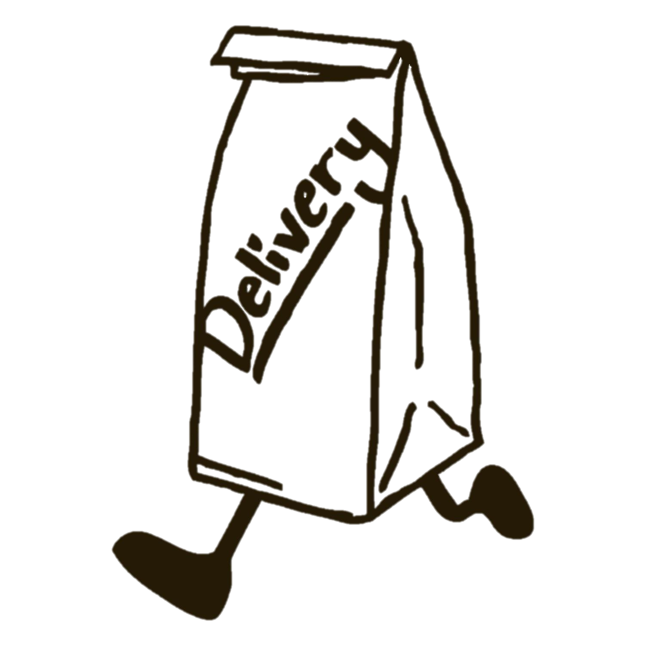
Final Project: Campus Delivery System
Group 3:
Lantzen Lowe
Marissa Oxford
Adam zeid
Carson Groulx
Jesse Espinoza

Slide 2
Executive Summary
With the rise of COVID-19, delivery and take-out services are the only ways several restaurants are staying in business. Experts hypothesize the increase in demand for this food service may last even after this pandemic is resolved.
One customer segment, college students, benefit greatly from food delivery for several reasons:
Convenience during time-crunched schedules
Avoid campus parking/traffic
Lack of a kitchen & food storage in campus housing
BUT, there’s one big issue Universities have with campus delivery:
Delivery Personnel wandering around campus without a formal connection to the University, causing security concerns

Slide 3
Solution, Scope, & Business Rules
Proposed Solution:
University controlled third-party delivery service for students. The University can incentivize by applying meal plan credit to delivery and charging less than traditional delivery services. All delivery drivers will be students, thus solving the issue of unaffiliated persons on campus
Scope:
On-campus students can place a delivery order through the campus system from any of the registered restaurants. By having all orders delivered to a central location (campus), drivers will save more time and gas.
Business Rules:
This system will employ delivery drivers to retrieve customer food orders from nearby restaurants and deliver it to students and faculty on campus.
This project is based on a campus with a layout similar to the University of North Carolina at Charlotte.
This system prototype utilizes the idea of a delivery hub but will also be able to operate without one.
This system is meant only for college campuses to use for students and faculty while they are on campus, and not while they are away from campus.
This system could potentially be modified to fit business campuses seeking to reduce delivery traffic as well.

Slide 4
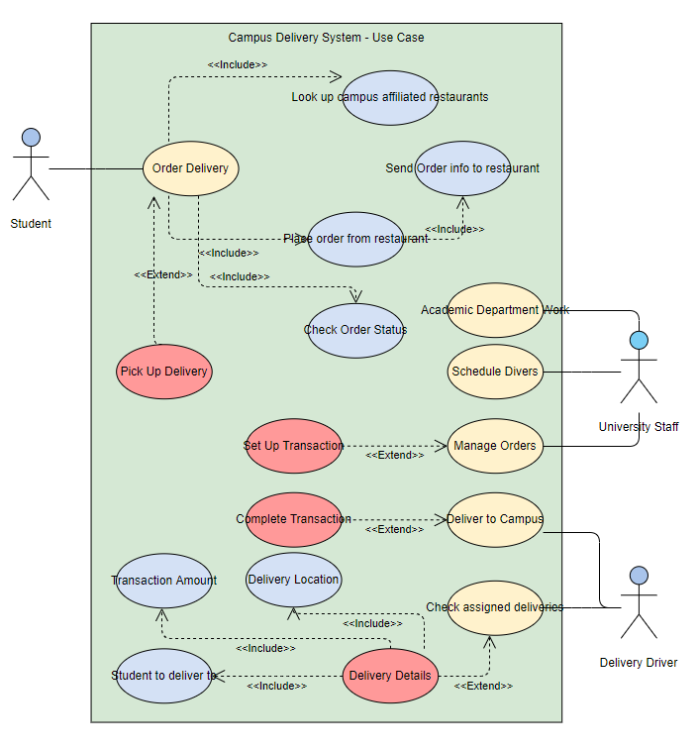
Use Case Diagram
This diagram illustrates the use/functionality of the proposed solution. Parties involved include:
Students
Order food delivery
Browse affiliated restaurants
Pick up delivery
University Staff
Communicate with affiliated restaurants
Manage orders and delivery drivers
Manage delivery system database
Delivery Drivers
Deliver orders from restaurants to campus
Check communications & assignments from university staff

Slide 5
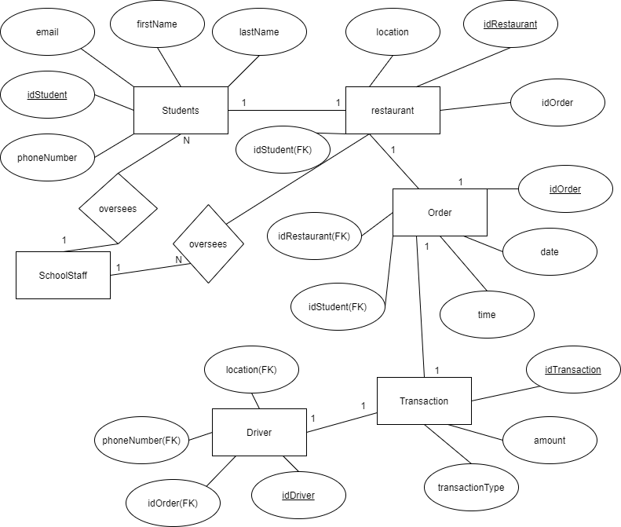
Proposed Database - EERD
In order to successfully operate the campus delivery system, a well-thought out and organized database will be required. This database will log all needed information such as orders, students, restaurants, etc. and their relationships to one another.
The following EERD shows a model of the database with each entity, attribute, and relationship necessary.

Slide 6
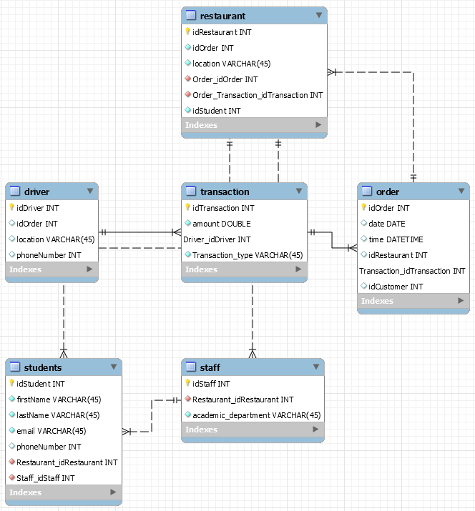
Proposed Database - Schema
The schema shows another view of the database where each table provides information on an entity and the attributes associated with it. The schema also shows the relationships between entities and each of their primary or foreign keys.

Slide 7
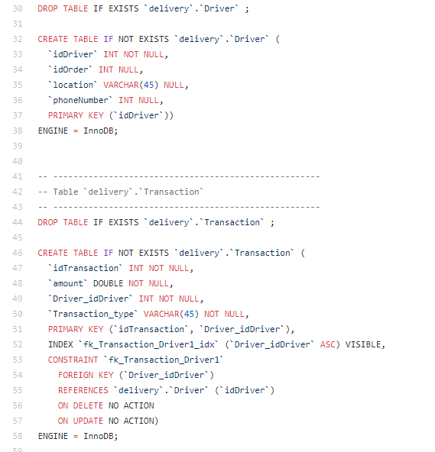
Data Dictionary (meta data)
The following image is a snippet of the SQL script used to create the schema for the campus delivery database. This piece includes the scripts to create the “Driver” and “Transaction” tables and are useful to show each attribute of the tables, their constraints, and relations to attributes in other tables.

Slide 8
Documentation of advanced sql statements

